Slide 1
What we are going to Learn
Commands in DotNEt Core
Creating MVC Core Project From Scratch using CLI Command

Slide 2
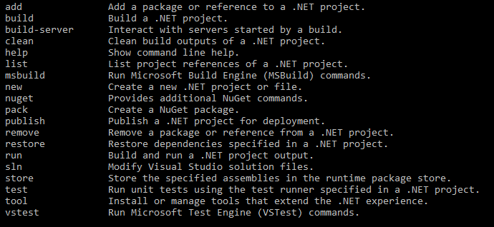
Commands in Dotnet Core dotnet –help

Slide 3
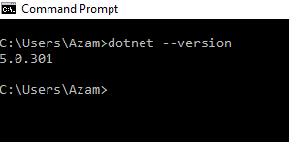
commands in Dotnet Core
How to Know Version of Dotnet Core?
dotnet –version

Slide 4
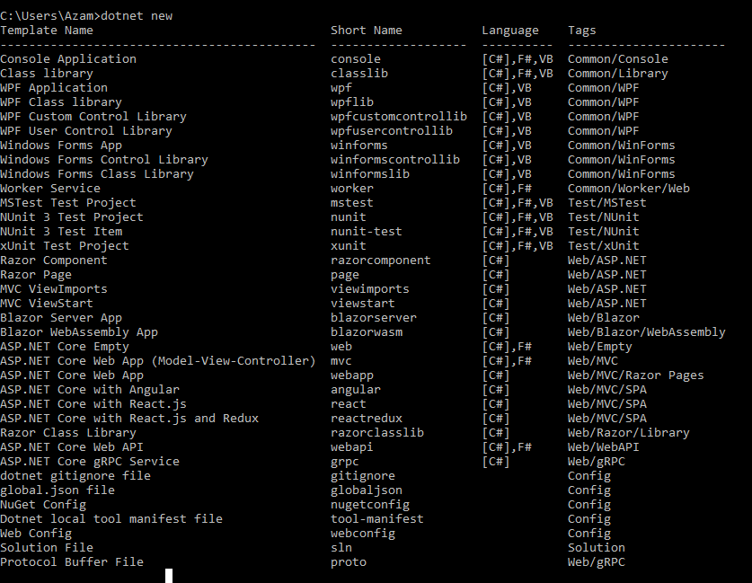
Dotnet Project Command

Slide 5

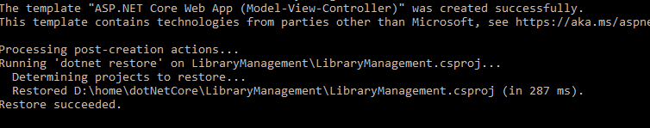
Steps to Create MVC Core Project using Command Line
Step1:
Create a Folder D:\home\dotNetCore
Step2:
Open cmd prompt type below command:

Slide 6
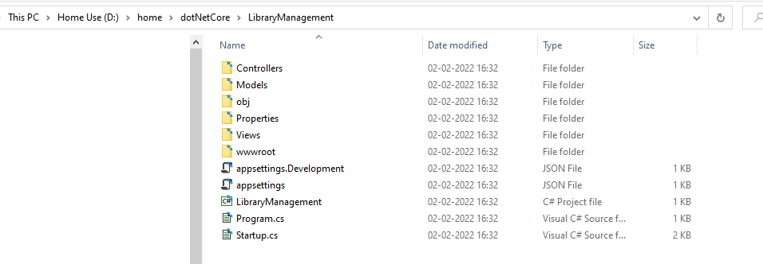
Library Management Project Created

Slide 7
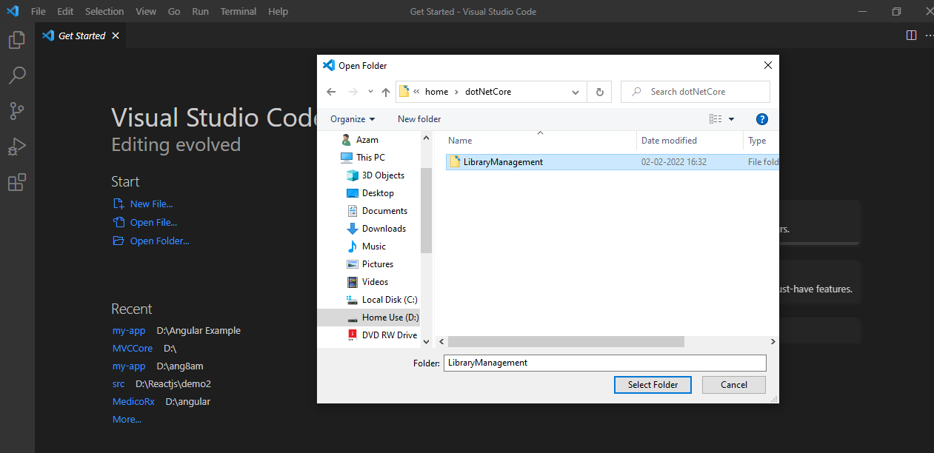
Open Project using Visual studio code and Run it

Slide 8
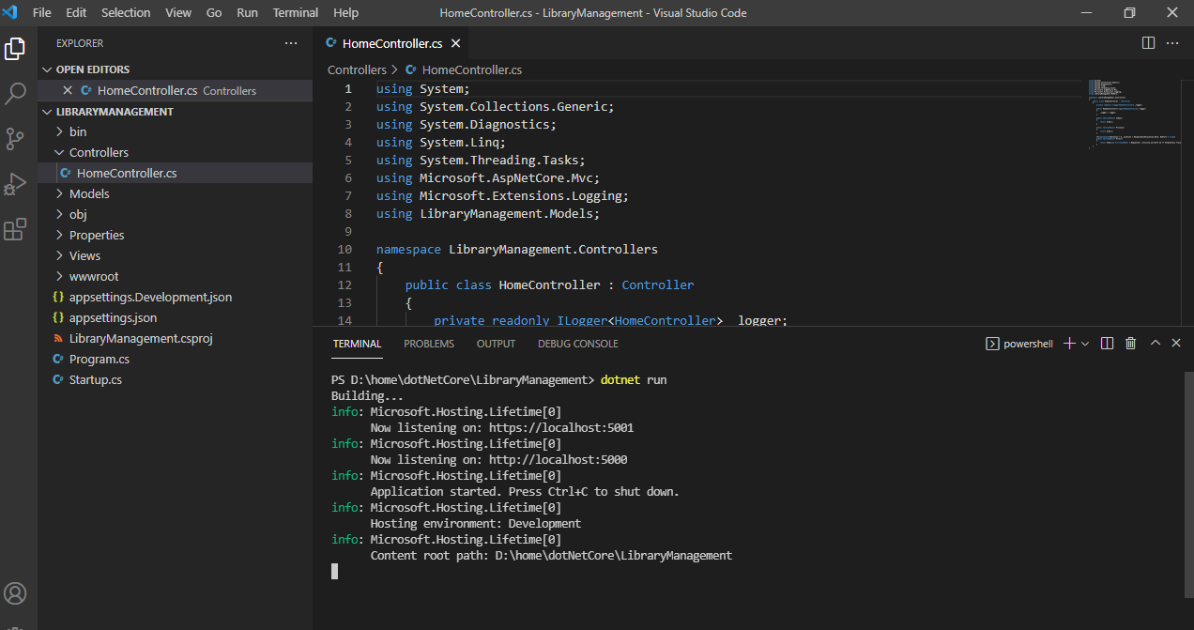

Slide 9
